Slide 1
Gender Pay Gap Report
April 2023

Slide 2
Rail infrastructure, engineering, electrification & training specialists
QTS Group is one of the UK’s leading rail contractors, providing specialist services in rail engineering, infrastructure, electrification & training.
We provide specialist services in:
Vegetation Management
Drainage Services
Fencing
Training
Civil Engineering
Earthworks
Geotechnical Services
Industrial Rope Access
Specialist Plant Fleet
Electrification
Our clients include major organisations across the rail, utilities, construction and public sectors.
© All Rights Reserved QTS GROUP Ltd,
a wholly owned subsidiary of Renew Holdings plc
Rench Farm, Drumclog, ML10 6QJ
01357 440222 | enquiries@qtsgroup.com

Slide 3
At a glance…our gender pay gap
At a glance…our gender pay gap
Mean | Median
Gender Pay Gap
28.96% | 29.03%
Gender Bonus Gap
73.19% | 0.00%
Proportion of employees who receive a bonus
Male – 76.47% | Female – 79.17%
Total workforce - 480
Men – 409
Women - 71
Proportion of male and female in each pay quartile
Male | Female | Male | Female | Male | Female | Male | Female
59.17% | 40.83% | 92.50% | 7.50% | 94.17% | 5.83% | 95.00% | 5.00%
Lower |  | Lower Middle |  | Upper Middle |  | Upper
© All Rights Reserved QTS GROUP Ltd,
a wholly owned subsidiary of Renew Holdings plc
Rench Farm, Drumclog, ML10 6QJ
01357 440222 | enquiries@qtsgroup.com

Slide 4
What is QTS doing to address the gender pay gap?
There is no doubt that the COVID 19 pandemic has had a negative effect on our ability to engage with schools, young people and recruitment events as we have done in the past
QTS remains fully committed to the principle of equality in the workplace and has a clear policy to remunerate employees equally for the same or equivalent role
We recognise that the industry in which it operates has historically been male dominated with many roles falling within construction site base staff
Traditionally, engineering and construction are perceived as male roles, which consequently means that many jobs are occupied by men. We find that our applications for site based jobs are almost exclusively applied to by men.
Education in schools
More females in top jobs
Employer engagement within schools
Progression & encouragement from employers
Career opportunities for women
© All Rights Reserved QTS GROUP Ltd,
a wholly owned subsidiary of Renew Holdings plc
Rench Farm, Drumclog, ML10 6QJ
01357 440222 | enquiries@qtsgroup.com

Slide 5
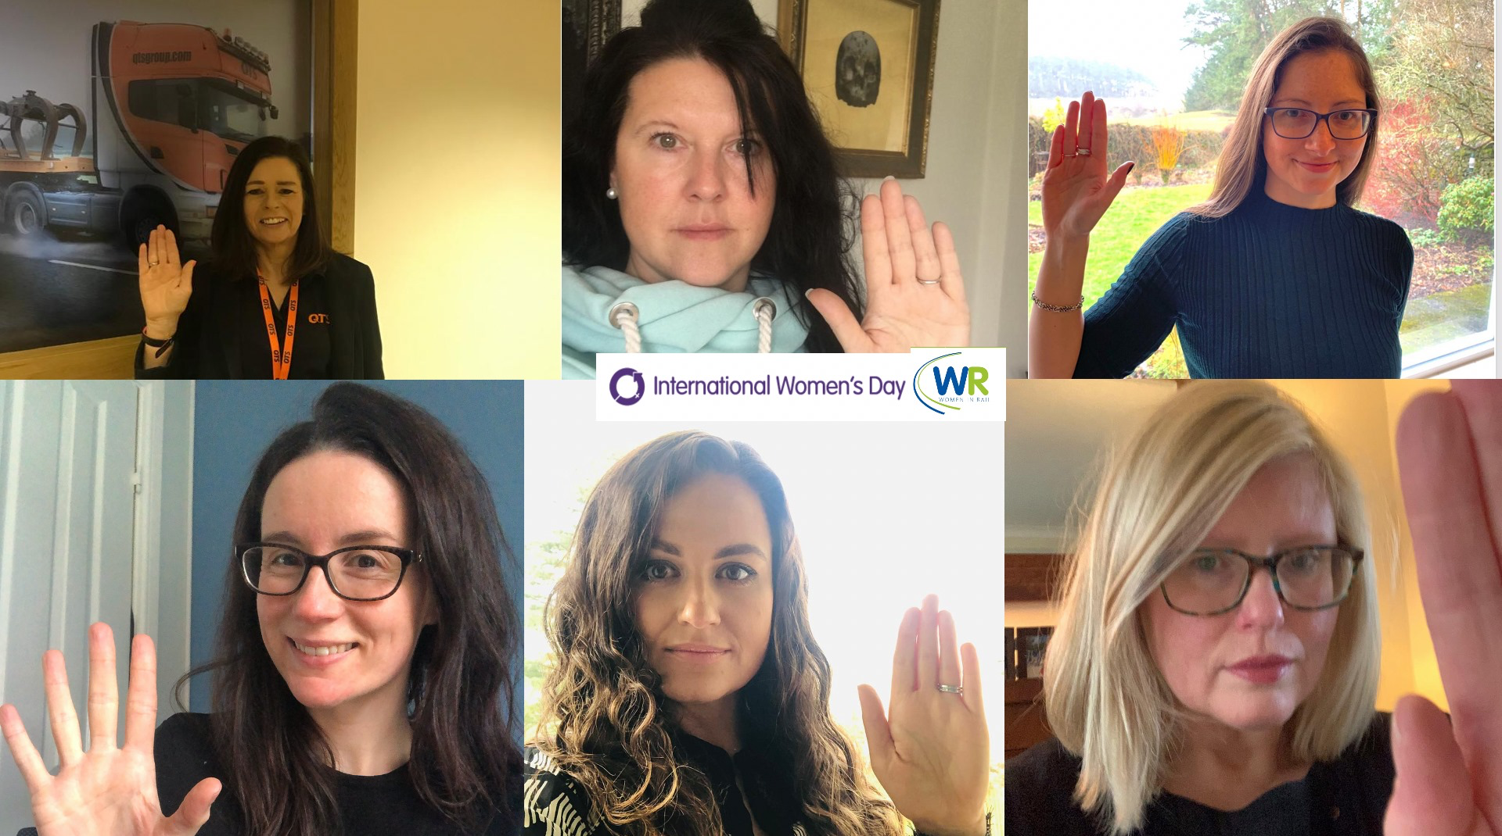
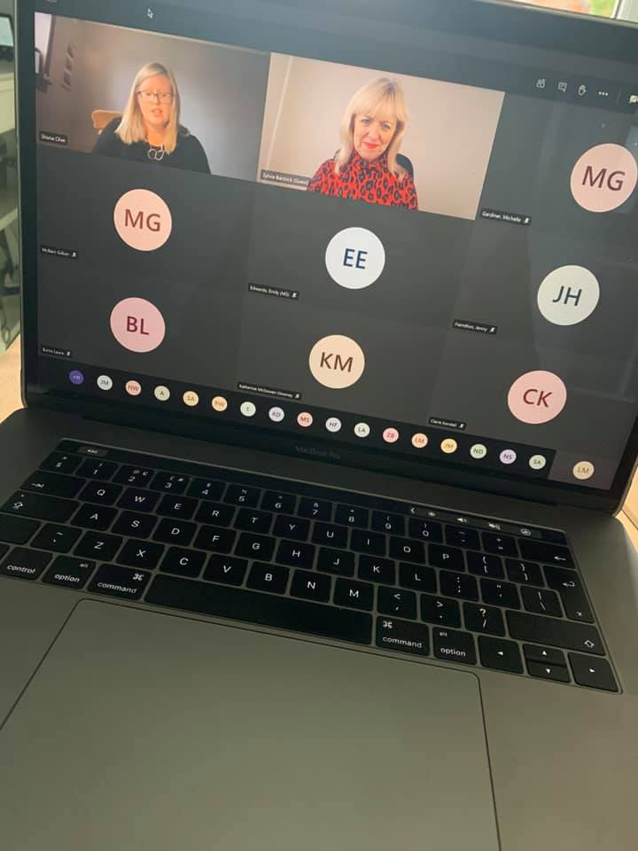
Women in Rail
QTS continues its commitment to Women in Rail Scotland and has two female employees on the steering group for Women in Rail
Although COVID has restricted face to face events, the committee has continued on with some successful online events across Scotland
Training Director, Lorna Gibson, is now the the Chair of Women in Rail Scotland and Head of Marketing, Lisa McKellar, remains an active participant in the group which organises events across Scotland
Women in Rail helps to support young people into a career in rail and provides valuable networking opportunities with other likeminded individuals
Women in Rail is committed to improving the diversity of the sector, an ethos which QTS is firmly aligned with
© All Rights Reserved QTS GROUP Ltd,
a wholly owned subsidiary of Renew Holdings plc
Rench Farm, Drumclog, ML10 6QJ
01357 440222 | enquiries@qtsgroup.com

Slide 6
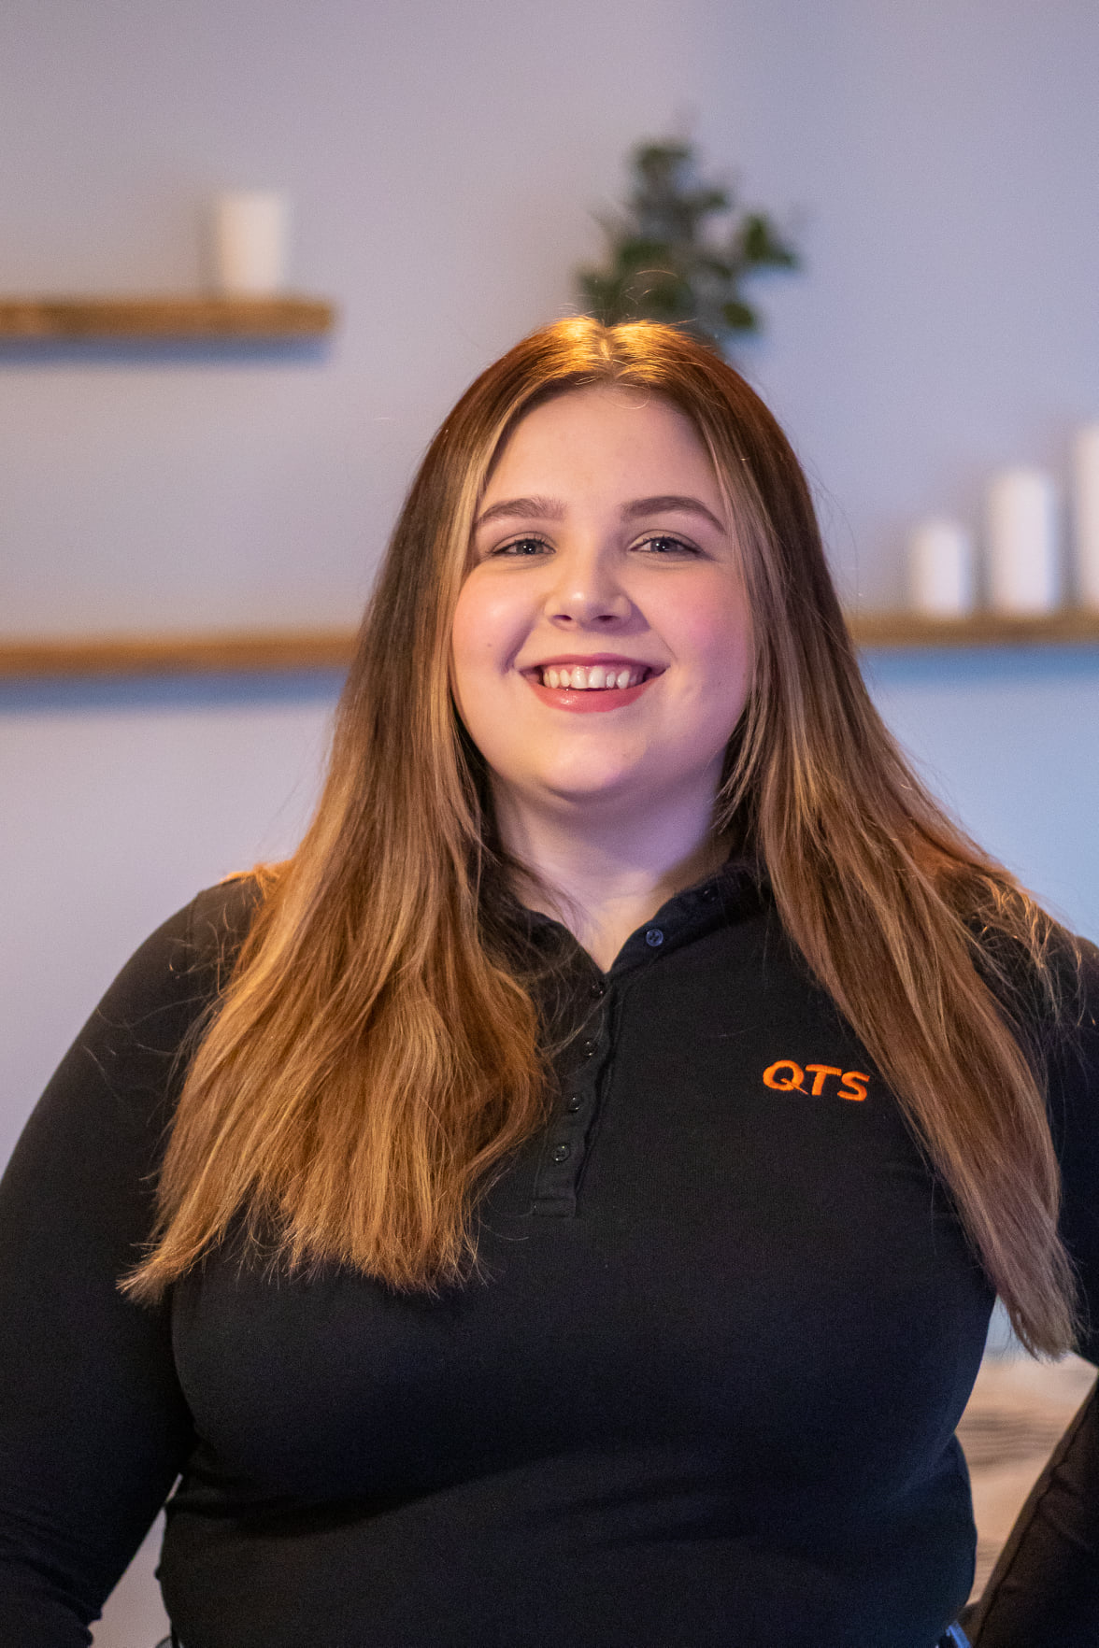
Education
QTS is committed to encouraging young women into STEM careers and is working hard to ensure that the next generation of school leavers are being educated and made aware of the opportunities that exist within this sector.
COVID 19 has made it difficult to do so in the traditional face to face sense, but remain committed to ensuring young women are aware of the great opportunities that are available in the rail industry
QTS is also the partner for business for Strathaven Academy and two of our female staff lead that liaison with the school, hosting mock interviews and attending career days.
© All Rights Reserved QTS GROUP Ltd,
a wholly owned subsidiary of Renew Holdings plc
Rench Farm, Drumclog, ML10 6QJ
01357 440222 | enquiries@qtsgroup.com

Slide 7
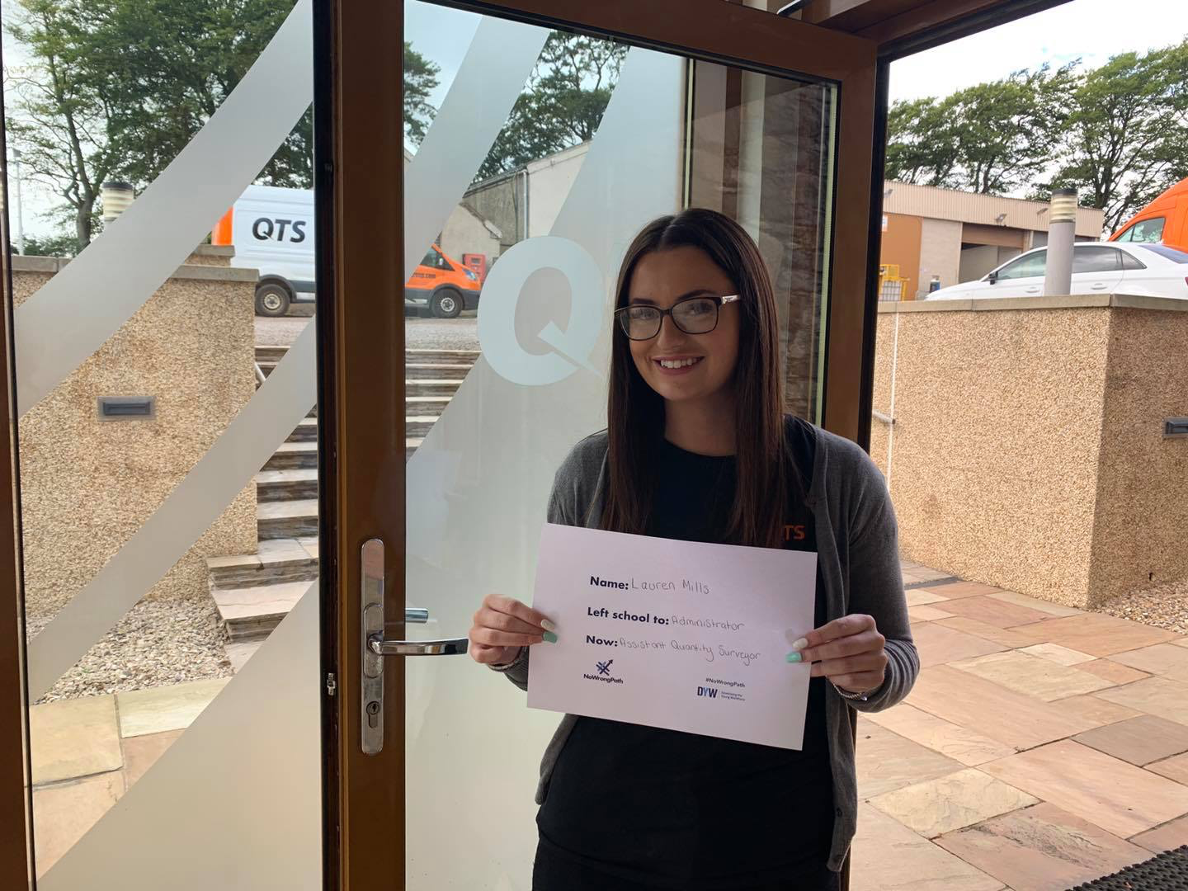
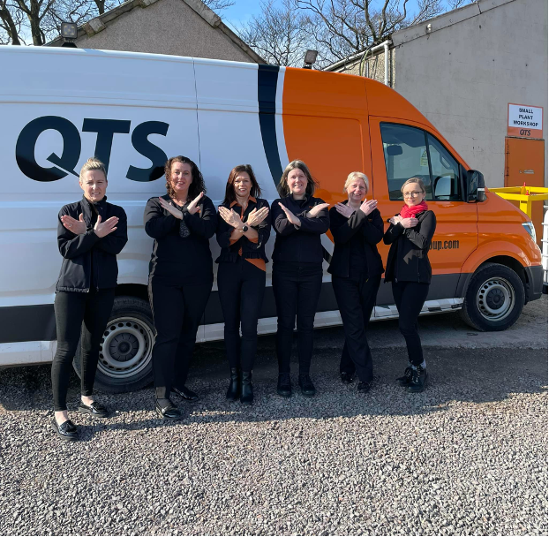
Progression
Across the QTS Group, 19 members of staff are carrying out traditional apprentices, modern apprenticeships, professional qualifications and undergraduate courses
3 of these are female, 16 are male
Women are not discriminated against when it comes to promotions and opportunities that arise within the company. Every application is considered, regardless of age, gender or ethnicity, and is filled purely on skillset and suitability for the job role.
However, the new applications for apprenticeships, and for the majority of site based jobs, are still predominately coming in from male applicants. This is why the education on encouraging females into the industry is so important
© All Rights Reserved QTS GROUP Ltd,
a wholly owned subsidiary of Renew Holdings plc
Rench Farm, Drumclog, ML10 6QJ
01357 440222 | enquiries@qtsgroup.com

Slide 8
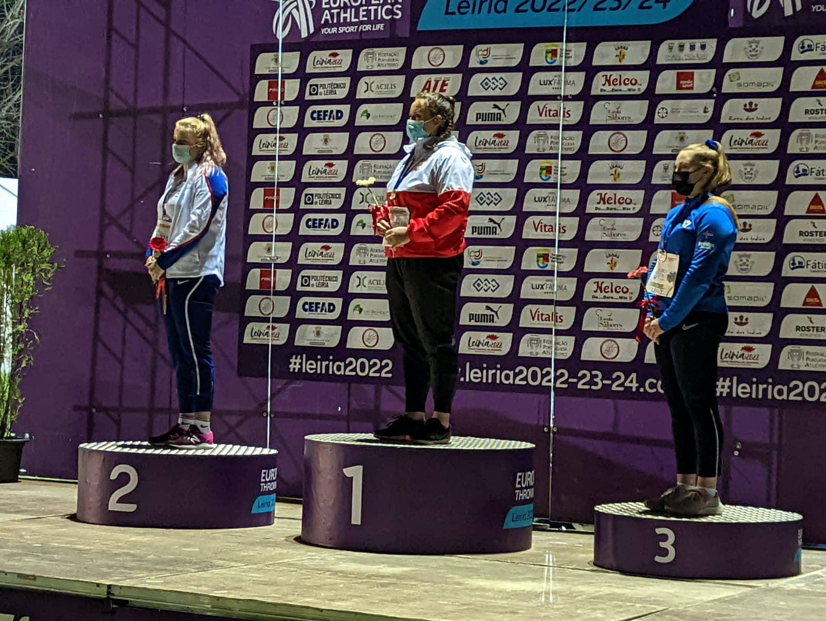
Women in Sport
Outwith the rail industry, QTS is also a big supporter of women in sport disciplines across the UK
We sponsor a variety of athletes throughout the UK, including ice dancing, boxing and swimming
We have three female athletes as part of our current intake of 10. We pledge to commit to taking on more female athletes through the lifespan of the programme
© All Rights Reserved QTS GROUP Ltd,
a wholly owned subsidiary of Renew Holdings plc
Rench Farm, Drumclog, ML10 6QJ
01357 440222 | enquiries@qtsgroup.com

Slide 9
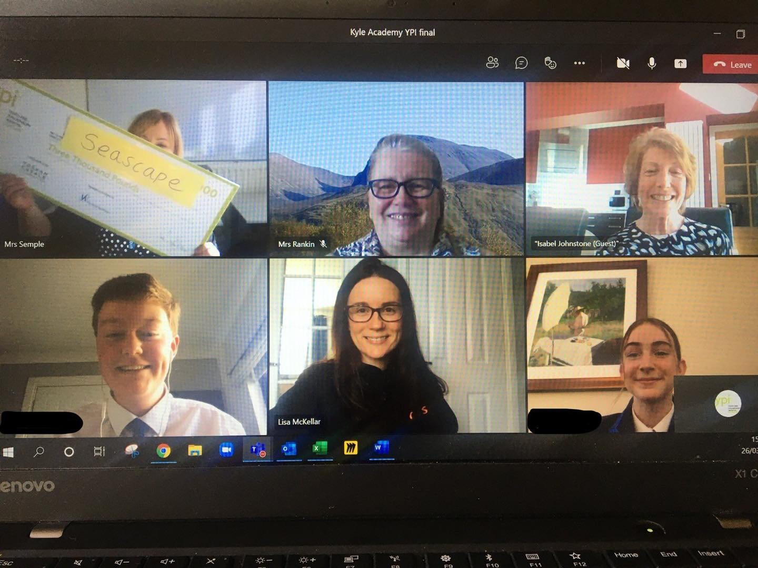
YPI
QTS continues to be a proud sponsor of the Youth & Philanthropy Initiative in the Ayrshire area
This programme helps both male and female students choose a social cause in the local area that affects their local community, identify a charity and put together a presentation to help secure that charity a £3,000 grant
Even through COVID, QTS continued to be involved with the schools through virtual mentoring and judging of finals
© All Rights Reserved QTS GROUP Ltd,
a wholly owned subsidiary of Renew Holdings plc
Rench Farm, Drumclog, ML10 6QJ
01357 440222 | enquiries@qtsgroup.com

Slide 10
Authorised signature
Jamie Lewis, Financial Director
© All Rights Reserved QTS GROUP Ltd,
a wholly owned subsidiary of Renew Holdings plc
Rench Farm, Drumclog, ML10 6QJ
01357 440222 | enquiries@qtsgroup.com

Slide 11
© All Rights Reserved
,
Rench Farm, Drumclog, ML10 6QJ
a wholly owned subsidiary of Renew Holdings plc
01357 440222 | enquiries@qtsgroup.com

